Slide 1
EDA PROJECT:
CREDIT RISK ANALYSIS
SARA NAAZ

Slide 2
PROBLEM STATEMENT:-
When the company receives a loan application, the company has to rights for loan approval based on the applicant’s profile. Two types of risks are associated with the bank’s or company’s decision:
If the aspirant is likely to repay the loan, then not approving the loan tends in a business loss to the company
If the a is aspirant not likely to repay the loan, i.e. he/she is likely to default/fraud, then approving the loan may lead to a financial loss for the company.

Slide 3
BUSINESS GOAL
This case study aims to identify patterns that indicate if an applicant will repay their instalments which may be used for taking further actions such as denying the loan, reducing the amount of loan, lending at a higher interest rate, etc. This will make sure that the applicants capable of repaying the loan are not rejected. Recognition of such aspirants using Exploratory Data Analysis (EDA) techniques is the main focus of this case study.

Slide 4
STEPS
Understanding Data:
Objective: Gain a clear understanding of the dataset and its features.
Review the dataset's structure, columns, and data types.
Check for any preliminary patterns or trends.
Identify potential challenges or outliers.
Merging Datasets:
Objective: Combine multiple datasets if necessary for a comprehensive analysis.
Ensure there's a common key or column to merge on.
Choose the appropriate type of merge (e.g., inner, outer, left, right).
Validate the merged dataset for consistency.
Handling Missing Values:
Objective: Address any gaps or missing information in the dataset.
Identify and quantify missing values.
Decide on an approach to handle missing data (imputation, deletion, or other methods).
Implement chosen strategy and validate the results.
Univariate Analysis:
Objective: Explore the characteristics of individual variables.
Use descriptive statistics (mean, median, mode) to summarize numerical variables.
Create frequency tables and histograms for categorical variables.
Identify outliers and anomalies.

Slide 5
Final Conclusion:
Objective: Summarize findings and draw conclusions from the analysis.
Synthesize insights gained from univariate and bivariate analyses.
Discuss any patterns, trends, or correlations discovered.
Make recommendations or decisions based on the analysis.
Bivariate Analysis:
Objective: Understand the relationships between pairs of variables.
Use correlation coefficients for numerical variables.
Create scatter plots, box plots, or other visualizations to explore relationships.
Perform statistical tests to validate observed patterns.

Slide 6
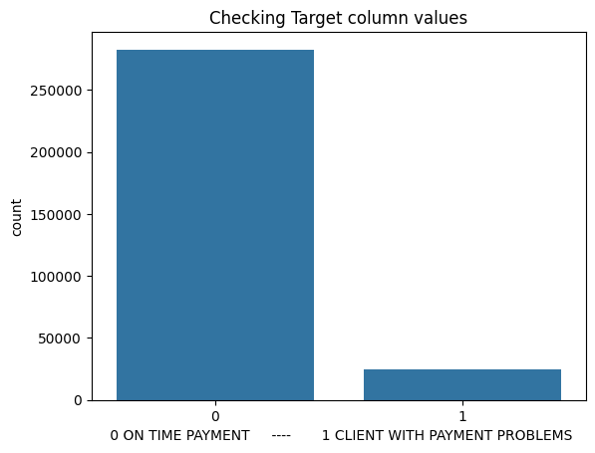
1. More clients have payments on time = 0
2. Clients have difficulties with there payments is low = 1

Slide 7
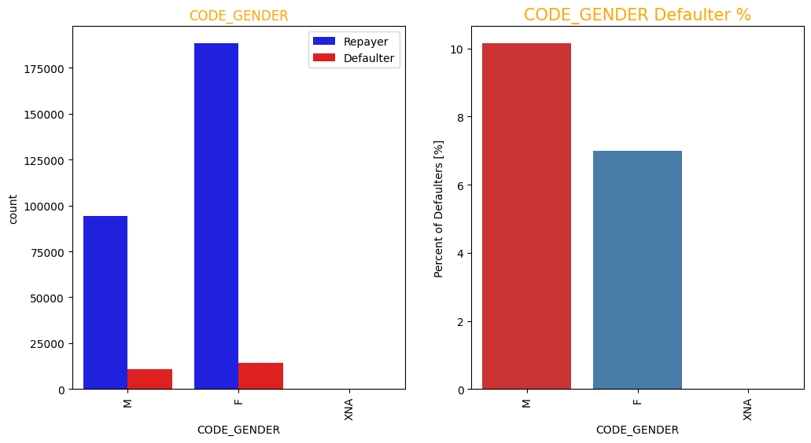
No. of female clients is almost double the amount of male clients, but males have a higher tendency to be defaulter.

Slide 8
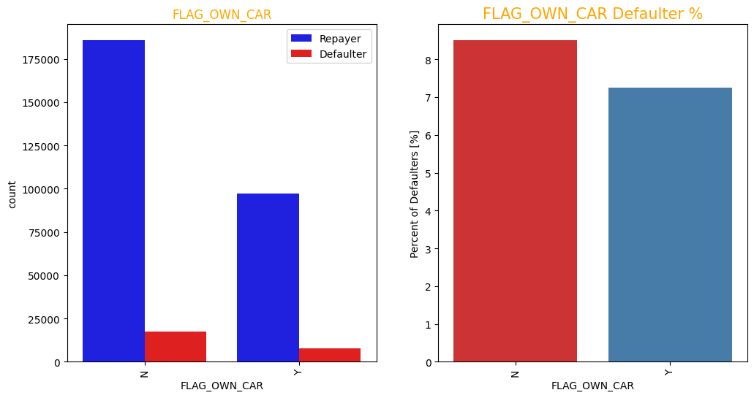
client with a car are double than clients without a car but it doesnt make a difference in determining whether the client will repay or not.

Slide 9
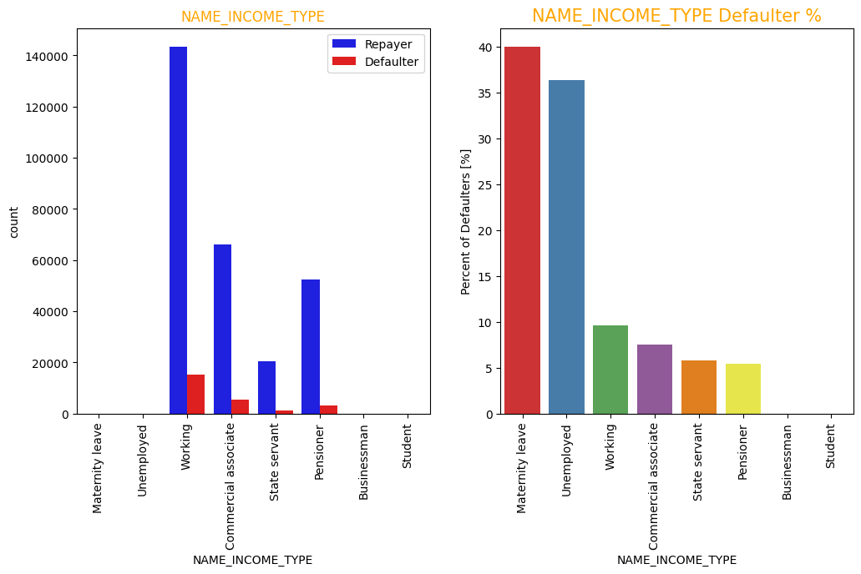
client without real estate are double than clients with real estate but it doesnt make a difference in determining whether the client will repay or not.

Slide 10
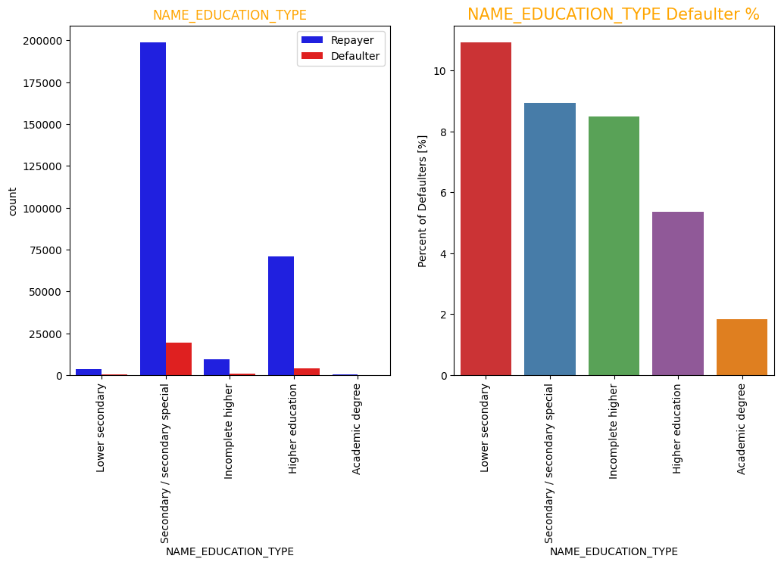
Almost all clients with lower secondary education will end up as defaulter and almost all clients with academic degree will repay the loan.

Slide 11
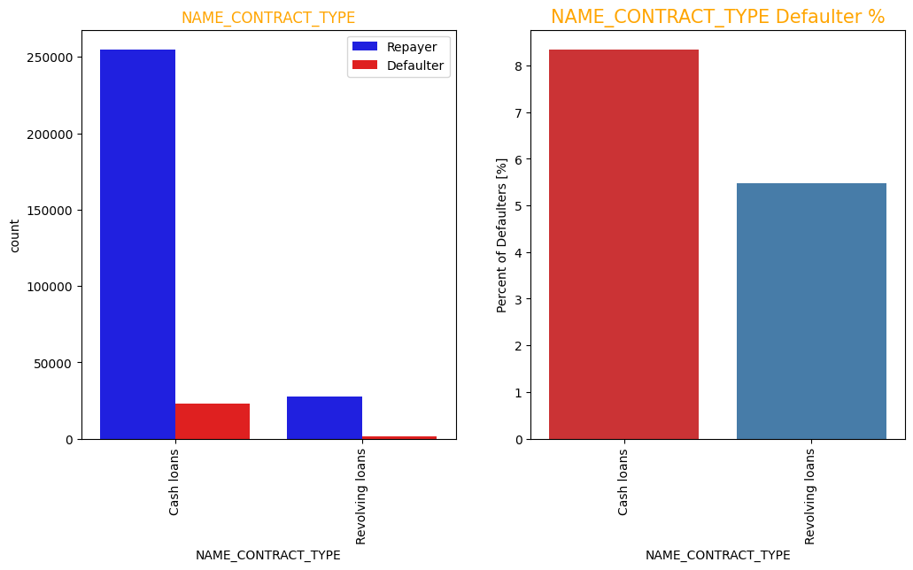
More than 90% of the loans applications are in the form of cash loans.

Slide 12
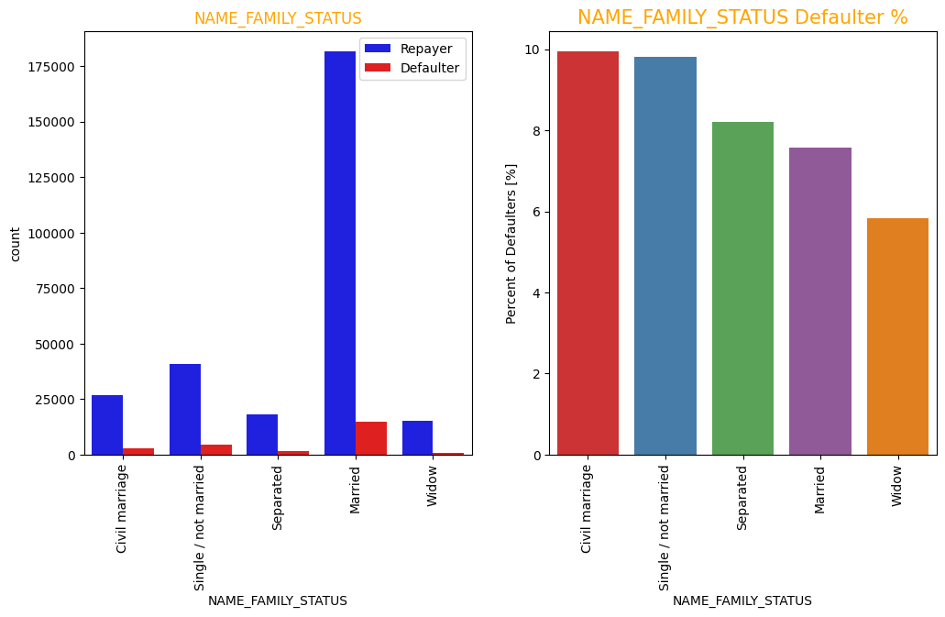
Majority of the clients are married.

Slide 13
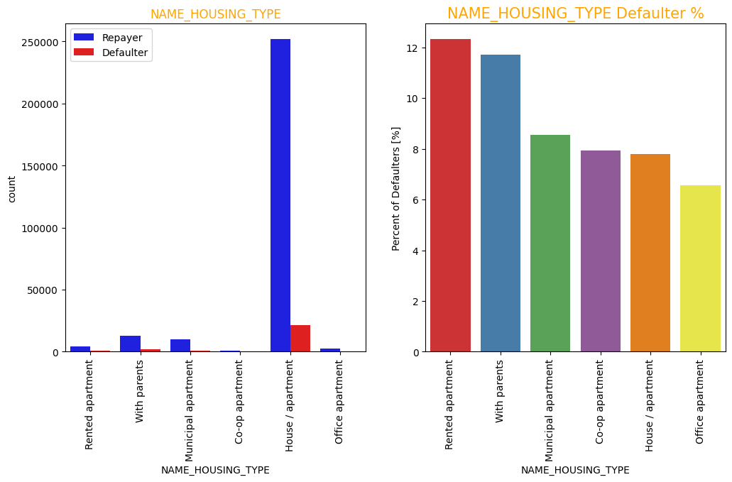
Clients with rented apartment are twice as more likely to end up as defaulter than clients with office apartments.

Slide 14
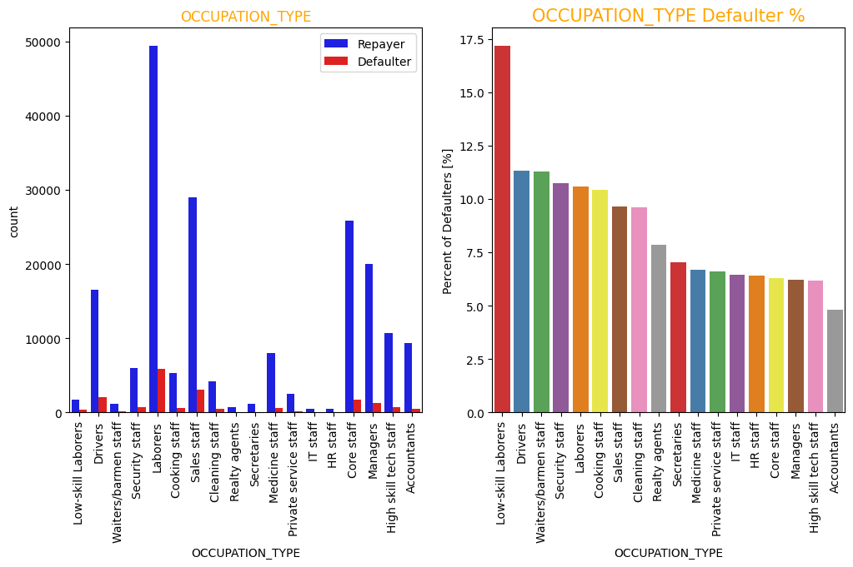
Labourers is the most common occupation type amongst applicants in this bank.

Slide 15
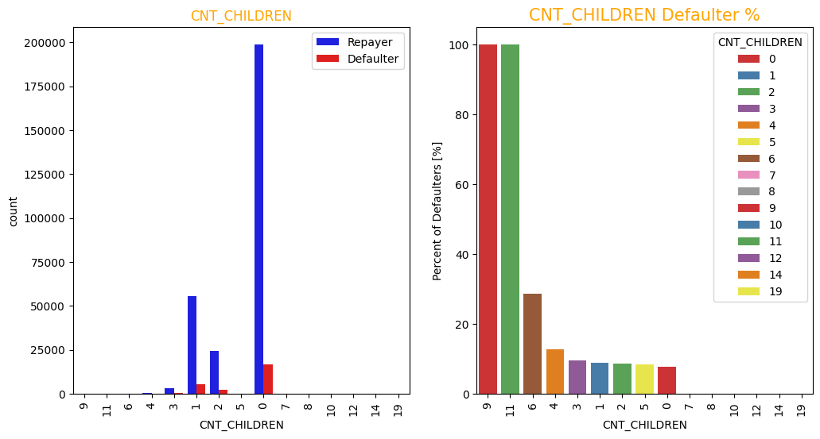
Clients with high no. of children (6-11) will almost certainly end up as defaulter.
clients with very low (0-1) children will most likely repay the loan.

Slide 16
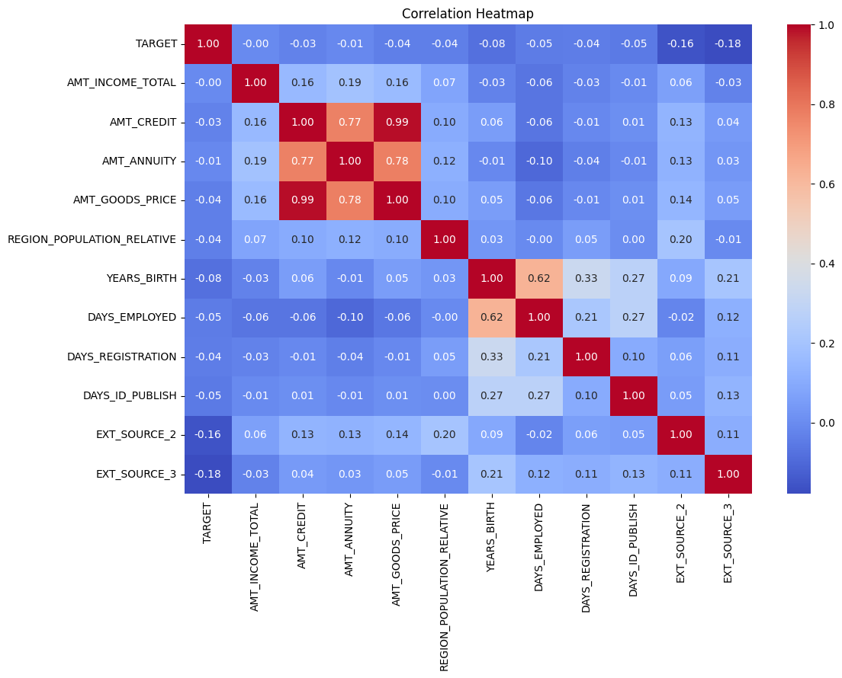
GOODS PRICE AND CREDIT AMOUTN HAVE A STRONG DIRECT RELATION.
NO. OF YEARS OF THE CLIENT SINCE BIRTH HAS A CONNECTION WITH THE NO. OF DAYS THAT THE CLIENT IS EMPLOYED.
ALSO, CREDIT AMOUNT HAS A DECENT CORRELATION WITH ANNUITY AMOUNT.
AND, GOODS PRICE HAS A CORRELATION WITH ANNYUITY AMOUNT.

Slide 17
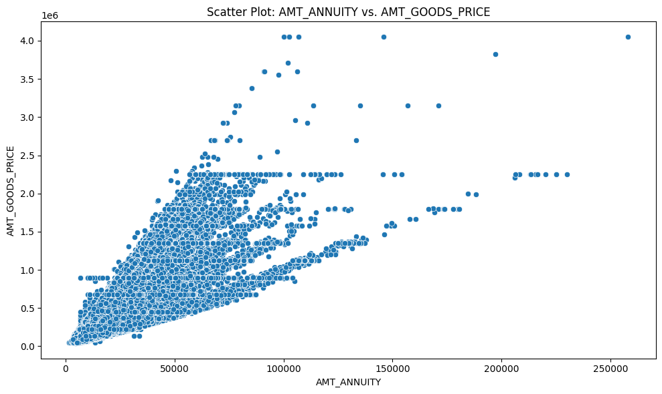
THERE IS A STRONG POSITIVE CORRELATION BETWEEN GOODS PRICE AND ANNUITY AMOUNT.
BOTH THE VARIABLES INCREASE WITH RESPECT TO THE OTHER.

Slide 18
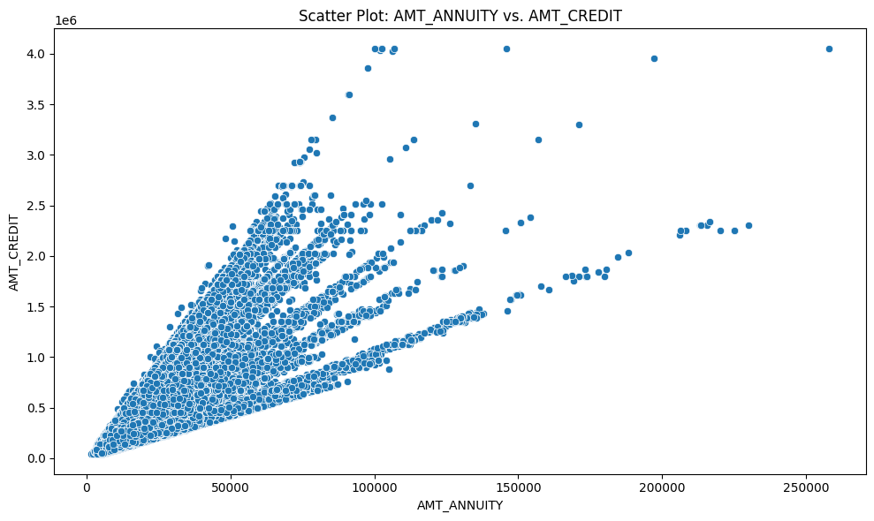
SIMILAR TO GOODS PRICE, ANNUITY AMOUNT ALSO HAS A STRONG CORRELATION WITH CREDIT AMOUNT.
CREDIT AMOUNT INCREASES AS ANNUITY AMOUNT INCREASES.

Slide 19
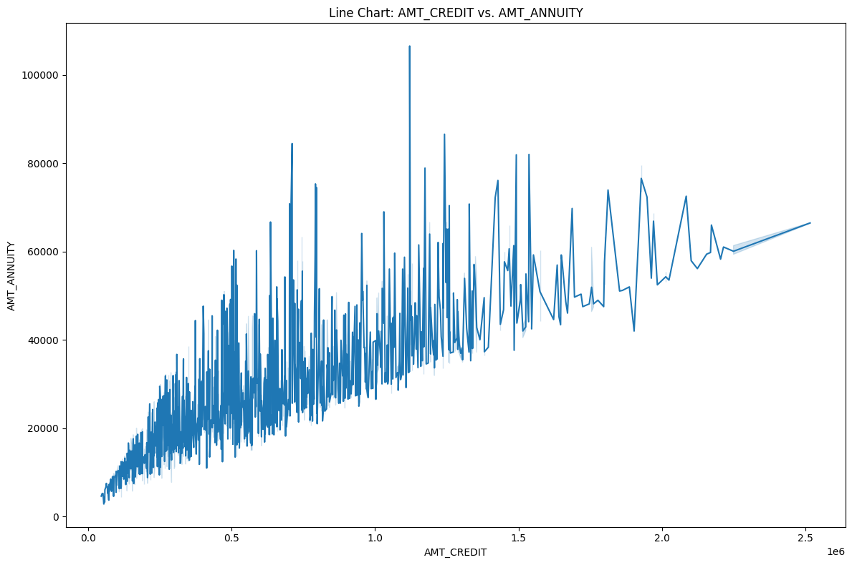
WE CAN SEE THAT ANNUITY AMOUNT GOES UP AS CREDIT AMOUNT IS INCREASING.
ALSO, MAJORITY OF THE DATA POINTS ARE ON THE LEFT HALF.

Slide 20
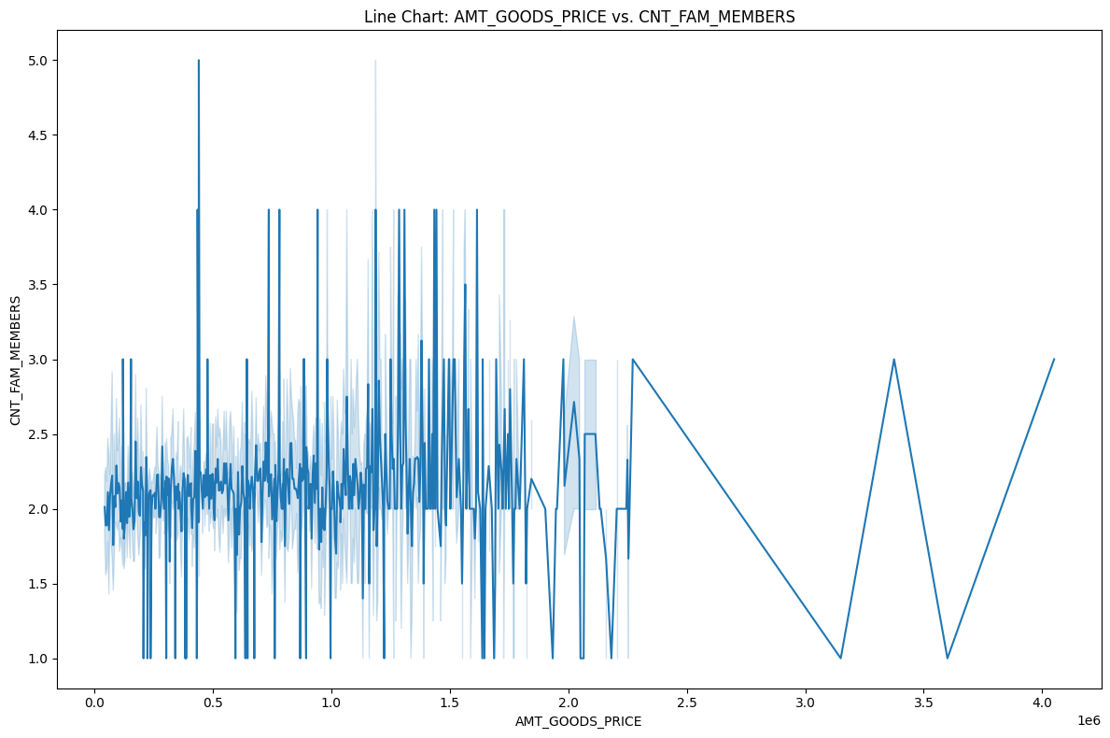
THE CHART IS FAIRLY UNIFORM WITH ALMOST ALL DATA POINTS IN THE LEFT HALF OF THE CHART.

Slide 21
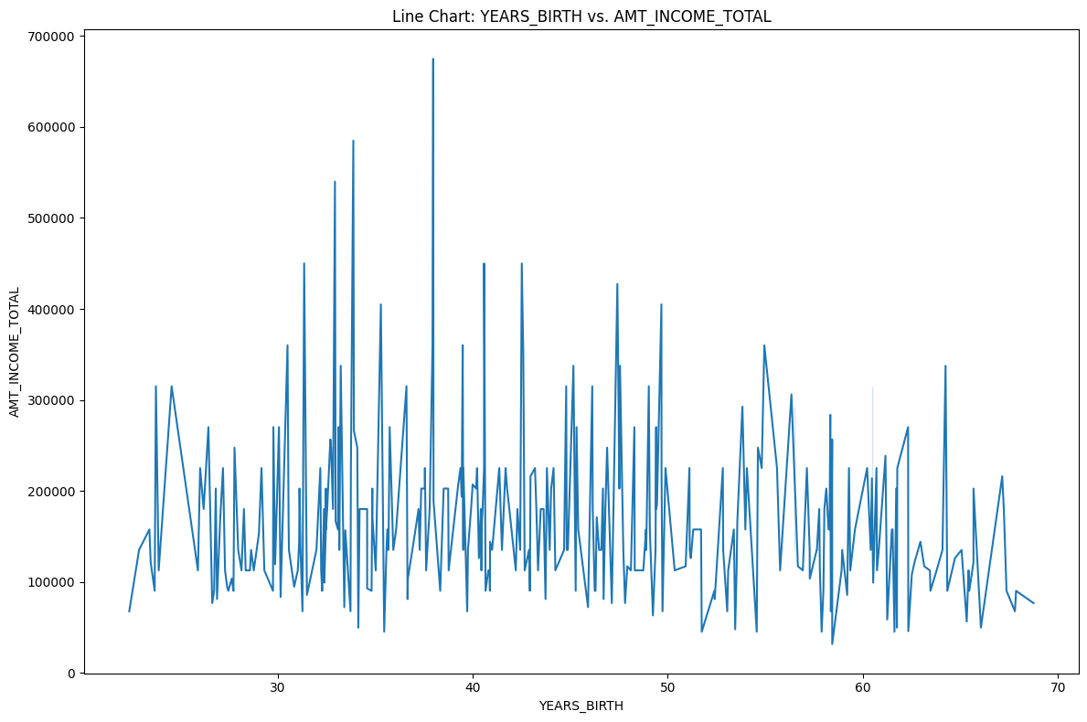
WE CAN SEE THAT INCOME AMOUNT IS DISTRIBUTED EQUALLY THROUGHOUT THE AGES.
THERE IS A SLIGHT INCREASE IN INCOME AMOUNT FOR AGES 30-40.

Slide 22
FINAL CONCLUSIONS:
CLIENTS TO ACCEPT:
HAVING AN ACADEMIC DEGREE
HAVING A HIGH PAYING JOB (ACCOUNTANTS, PRIVATE SERVICE STAFF)
WHO HAVE NO CHILDREN OR VERY FEW CHILDREN (0-1)
WITH THE AGE OF BETWEEN 30-50 YEARS
FEMALE CLIENTS SHOULD BE GIVEN SLIGHT PREFERENCE OVER MALE CLIENTS
RESIDE IN AN OFFICE APARTMENT
CLIENTS TO REJECT:
WHO HAVE LOW-SKILLED LABOURER AS THE OCCUPATION
WITH A HIGH CHILD COUNT (6-12)
RESIDE IN RENTED APARTMENTS
WHO HAVE A HIGH FAMILY MEMBER COUNT
YOUNG CLIENTS (LESS THAN 25 YEARS OF AGE)
OLD CLIENTS (MORE THAN 62 YEARS OF AGE)
WHO HAVE A LOWER-SECONDARY EDUCATION ONLY (OR LESSER THAN THAT)

